Slide 1
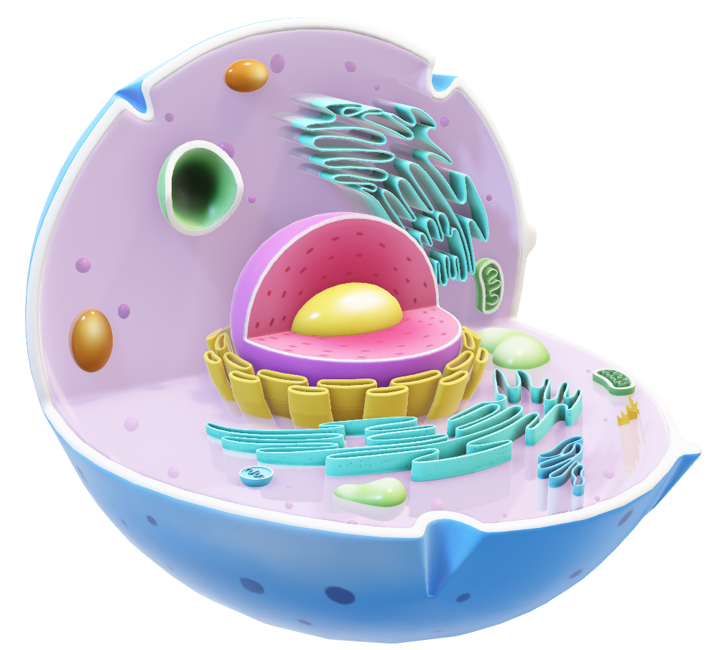
CELL AS THERAPEUTIC AGENT
JSS ACADEMY OF HIGHER EDUCATION AND RESEARCH
Department of Biotechnology and Bioinformatics
TISSUE ENGINEERING AND REGENERATIVE MEDICINE
COURSE COORDINATOR:
Dr. Gopenath T S
PRESENTED BY:
Aishwarya M
Chaithra S
S Varsha
Sandhya Elumalai
Vishalakshi V S

Slide 2
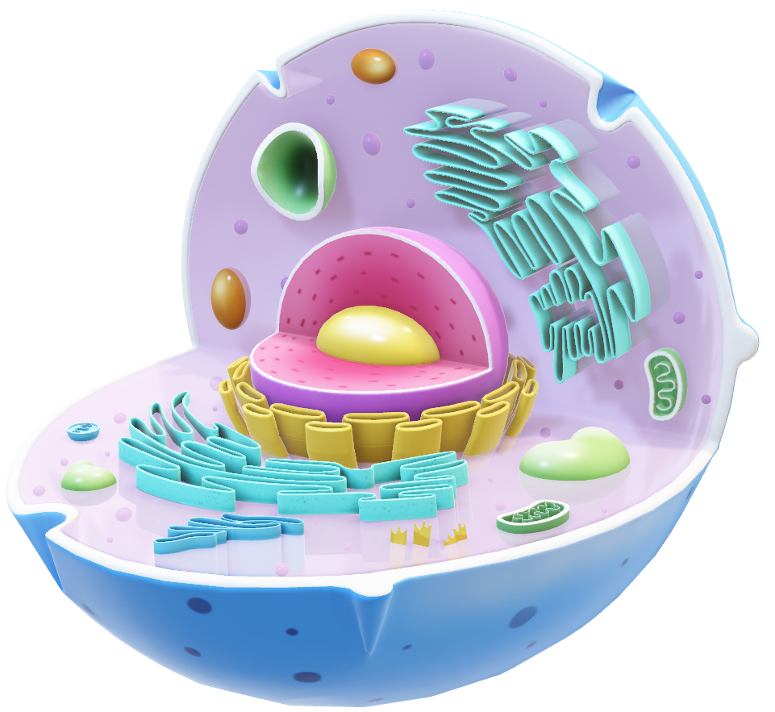
JSS ACADEMY OF HIGHER EDUCATION AND RESEARCH
Department of Biotechnology and Bioinformatics
TISSUE ENGINEERING AND REGENERATIVE MEDICINE
COURSE COORDINATOR:
Dr. Gopenath T S
PRESENTED BY:
Aishwarya M
Chaithra S
S Varsha
Sandhya Elumalai
Vishalakshi V S
INTRODUCTION TO CELL AS THERAPEUTIC AGENTS
Cells are used as therapies to treat diseases by regenerating tissue, modulating immunity, or targeting cancer.
Types include:
Stem Cells
Immune Cells (like CAR-T)
Pancreatic Islet Cells
Act by replacing damaged cells, secreting healing factors, or directly attacking diseased cells.
Challenges include safety, scalability, personalization, and strict regulatory requirements.

Slide 3
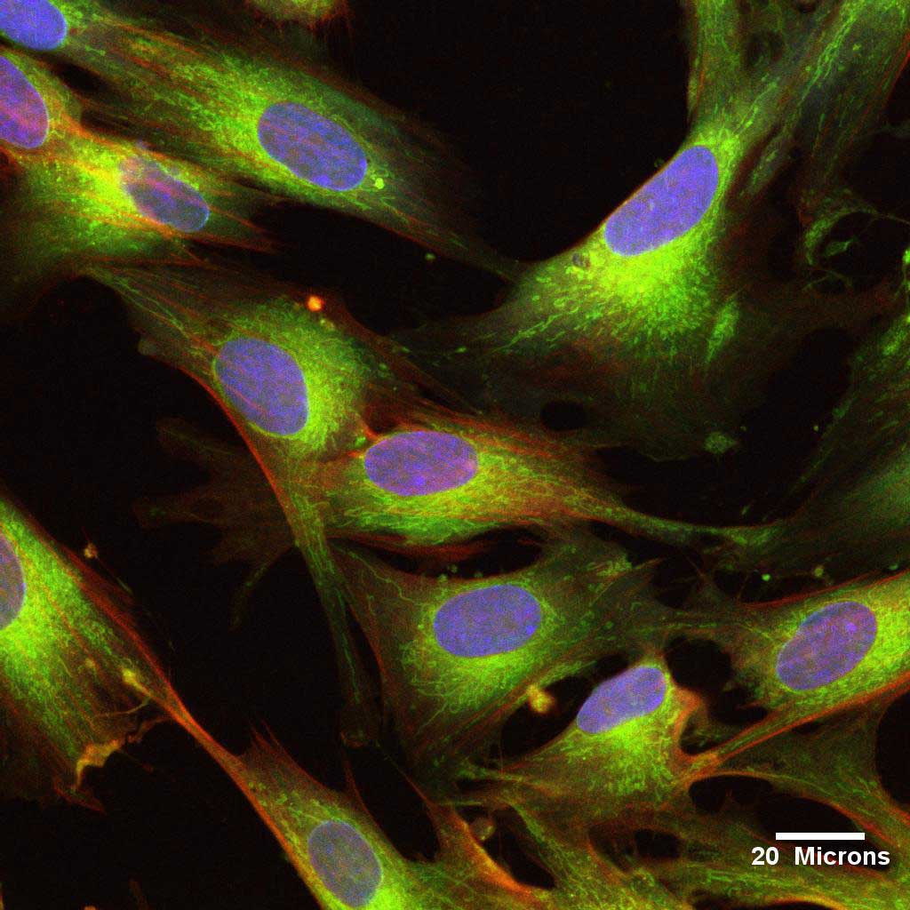
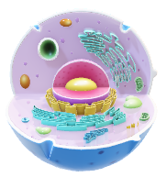
INTRODUCTION TO CELL AS THERAPEUTIC AGENTS
Cells are used as therapies to treat diseases by regenerating tissue, modulating immunity, or targeting cancer.
Types include:
Stem Cells
Immune Cells (like CAR-T)
Pancreatic Islet Cells
Act by replacing damaged cells, secreting healing factors, or directly attacking diseased cells.
Challenges include safety, scalability, personalization, and strict regulatory requirements.
UMBILICAL CORD DERIVED MESENCHYMAL STEM CELLS
Source of mesenchymal stem cells: Human Umbilical Cord
Mesenchymal stromal cells: Attractive and promising tool for regenerative medicine
HUCMSCs: Therapeutic advantage to treat several diseases like autoimmune & neurodegenerative diseases

Slide 4
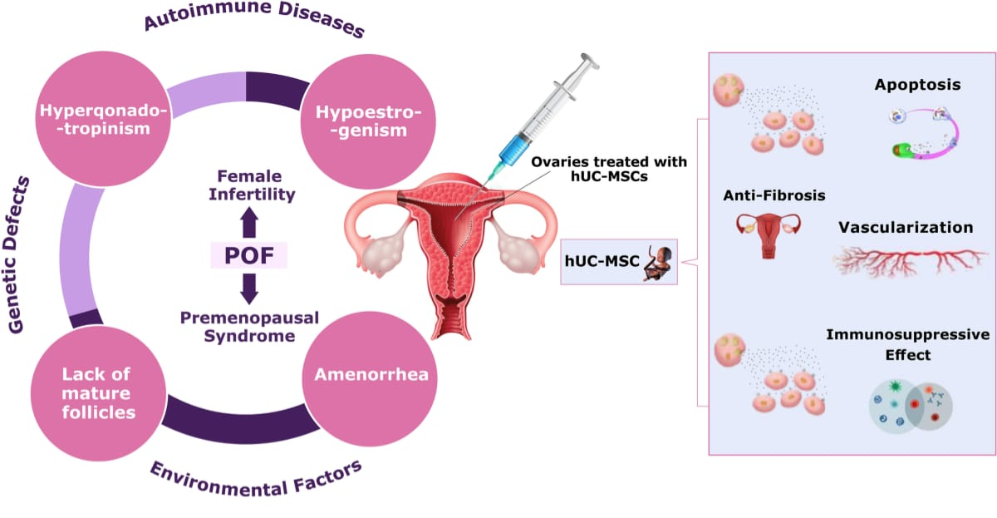
UMBILICAL CORD DERIVED MESENCHYMAL STEM CELLS
Source of mesenchymal stem cells: Human Umbilical Cord
Mesenchymal stromal cells: Attractive and promising tool for regenerative medicine
HUCMSCs: Therapeutic advantage to treat several diseases like autoimmune & neurodegenerative diseases

Slide 5
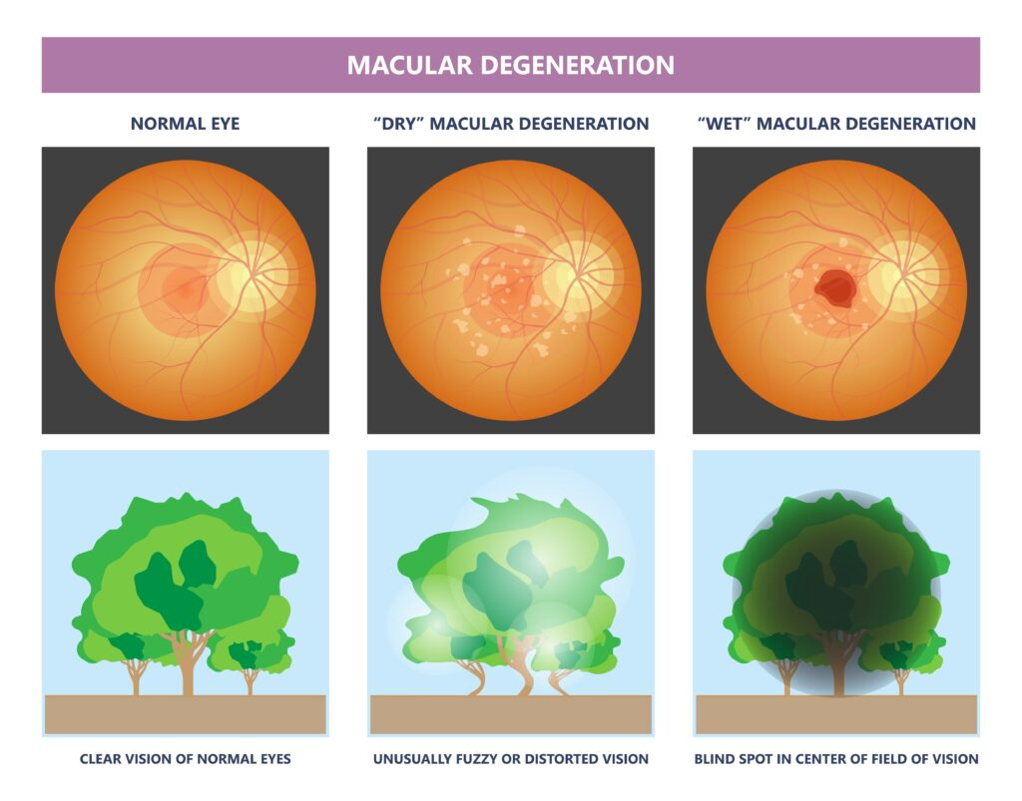
EYE CELL-BASED THERAPY
Why Eye Cells?
The human eye is a highly specialized organ but has limited ability to regenerate once cells are lost.
Advantages of the Eye as a Target for Cell Therapy:
Immune-privileged site
Small, enclosed space
Allows direct visualization and imaging

Slide 6
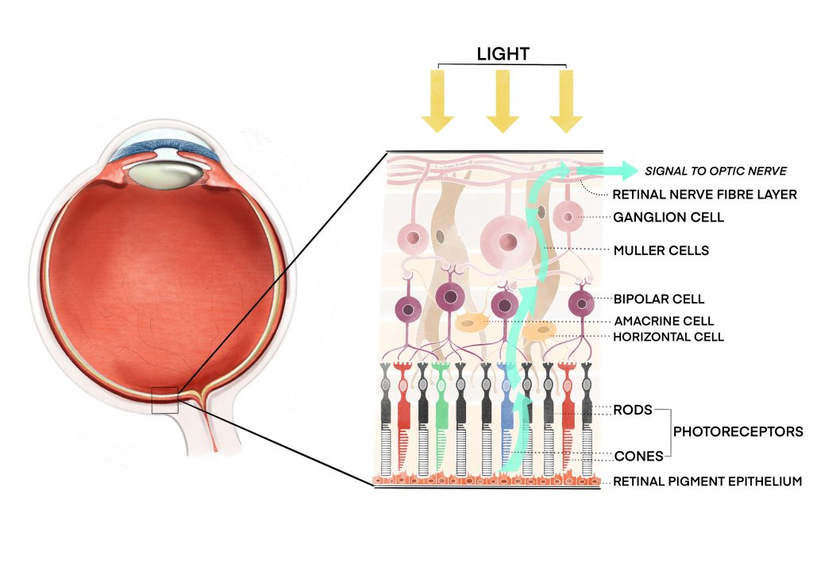
EYE CELL-BASED THERAPY
Why Eye Cells?
The human eye is a highly specialized organ but has limited ability to regenerate once cells are lost.
Advantages of the Eye as a Target for Cell Therapy:
Immune-privileged site
Small, enclosed space
Allows direct visualization and imaging
KEY EYE CELL TYPES USED IN THERAPY
1. Retinal Pigment Epithelial (RPE) Cells
Supports photoreceptors: nutrient transport, waste removal, light absorption.
Used in AMD treatment.
2. Photoreceptor Cells (Rods & Cones)
Essential for light detection and image formation.
Transplanted to restore vision in retinitis pigmentosa and AMD

Slide 7
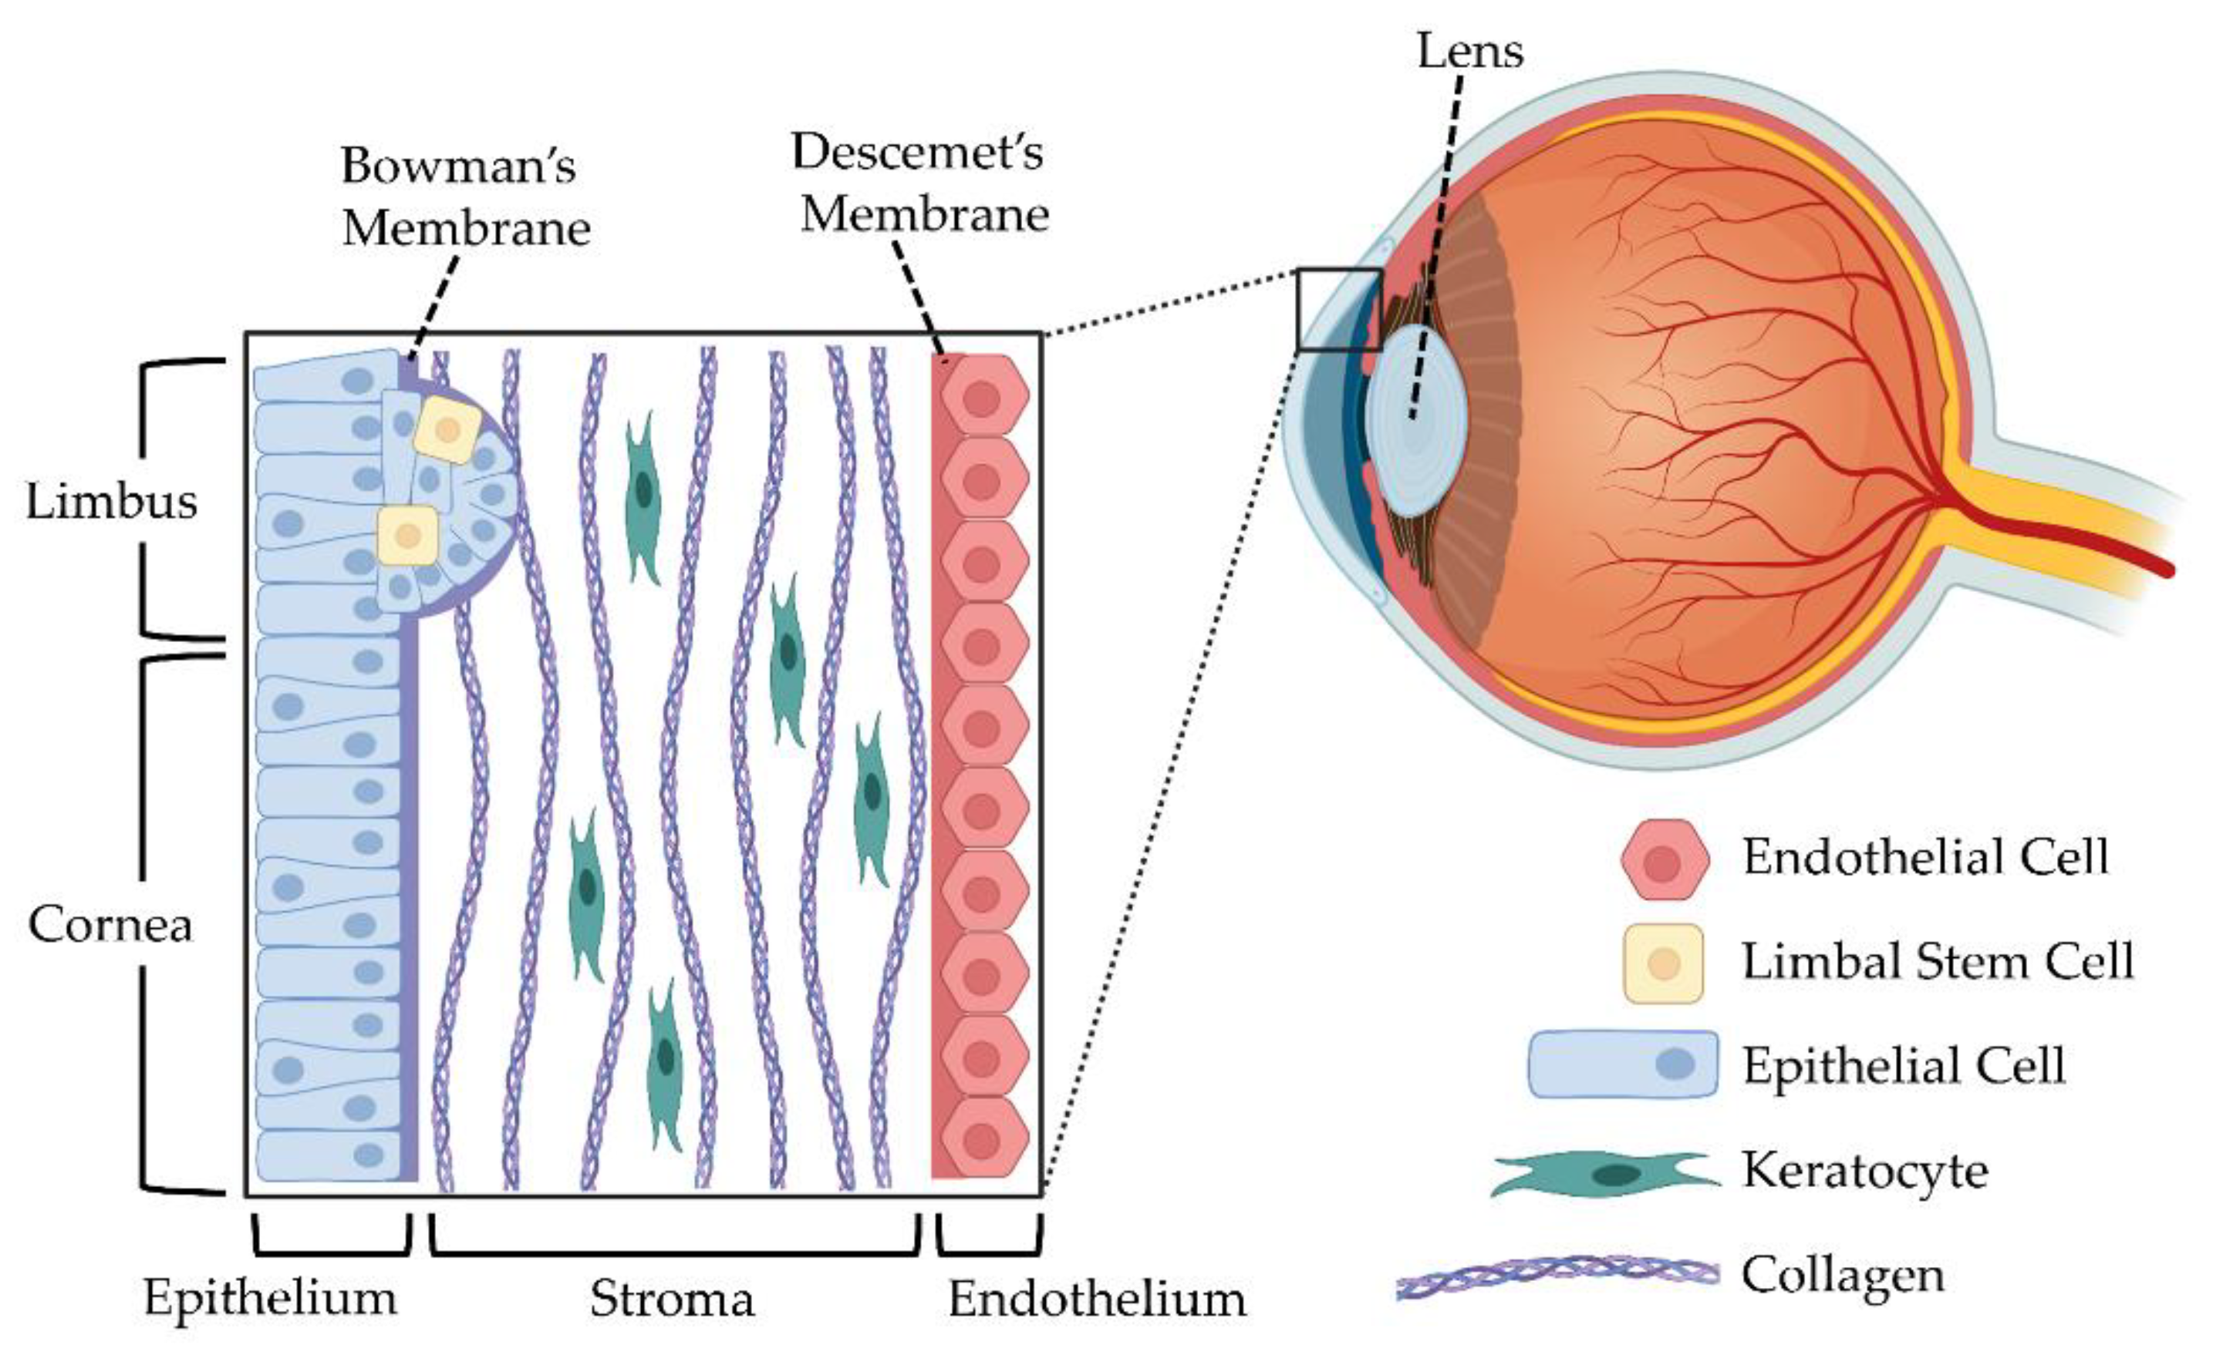
KEY EYE CELL TYPES USED IN THERAPY
1. Retinal Pigment Epithelial (RPE) Cells
Supports photoreceptors: nutrient transport, waste removal, light absorption.
Used in AMD treatment.
2. Photoreceptor Cells (Rods & Cones)
Essential for light detection and image formation.
Transplanted to restore vision in retinitis pigmentosa and AMD
KEY EYE CELL TYPES USED IN THERAPY
3. Limbal Stem Cells
Found at corneal limbus; regenerates corneal epithelium.
Used in treating limbal stem cell deficiency (LSCD).
4. Corneal Epithelial and Endothelial Cells
Epithelial: Ocular surface reconstruction.
Endothelial: Maintains corneal transparency.

Slide 8
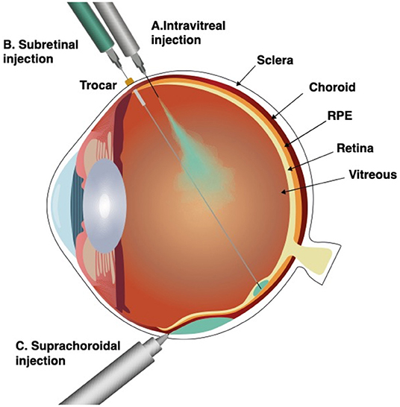
KEY EYE CELL TYPES USED IN THERAPY
3. Limbal Stem Cells
Found at corneal limbus; regenerates corneal epithelium.
Used in treating limbal stem cell deficiency (LSCD).
4. Corneal Epithelial and Endothelial Cells
Epithelial: Ocular surface reconstruction.
Endothelial: Maintains corneal transparency.
CELL DELIVERY TECHNIQUES
Subretinal delivery: Between the retina and retinal pigment epithelium, offering direct access to photoreceptors and RPE cells.–
Intravitreal injection: Into the vitreous cavity, minimally invasive.
Suprachoroidal delivery: Targets the space between the sclera and choroid.

Slide 9
CELL DELIVERY TECHNIQUES
Subretinal delivery: Between the retina and retinal pigment epithelium, offering direct access to photoreceptors and RPE cells.–
Intravitreal injection: Into the vitreous cavity, minimally invasive.
Suprachoroidal delivery: Targets the space between the sclera and choroid.
MECHANISM OF ACTION
Cell Replacement: Replaces damaged or lost retinal or corneal cells.
Neuroprotection: Secretion of trophic factors to protect existing neurons and delay degeneration.
Immune Modulation: Reduce local inflammation and modulate immune responses in ocular diseases.
Structural Support: Help restore damaged tissue architecture and maintain barrier functions.
Functional Recovery: Integration leads to partial or full recovery of visual function, depending on cell type and delivery.
Paracrine Effects: Influence surrounding tissue via signaling molecules without integrating directly.

Slide 10
MECHANISM OF ACTION
Cell Replacement: Replaces damaged or lost retinal or corneal cells.
Neuroprotection: Secretion of trophic factors to protect existing neurons and delay degeneration.
Immune Modulation: Reduce local inflammation and modulate immune responses in ocular diseases.
Structural Support: Help restore damaged tissue architecture and maintain barrier functions.
Functional Recovery: Integration leads to partial or full recovery of visual function, depending on cell type and delivery.
Paracrine Effects: Influence surrounding tissue via signaling molecules without integrating directly.
CHALLENGES
Immune Rejection: Risk of host immune system attacking transplanted cells, especially with allogeneic sources.
Cell Survival and Integration: Ensuring transplanted cells survive, integrate properly, and function long-term in the hostile ocular environment.
Delivery Method Limitations: Difficulties in safely delivering cells to precise retinal or corneal locations without causing damage.
Scar Tissue and Inflammation: Host tissue scarring and inflammation can impair cell engraftment and function.
Tumorigenicity: Risk of uncontrolled cell growth or tumor formation, especially with pluripotent stem cells.

Slide 11
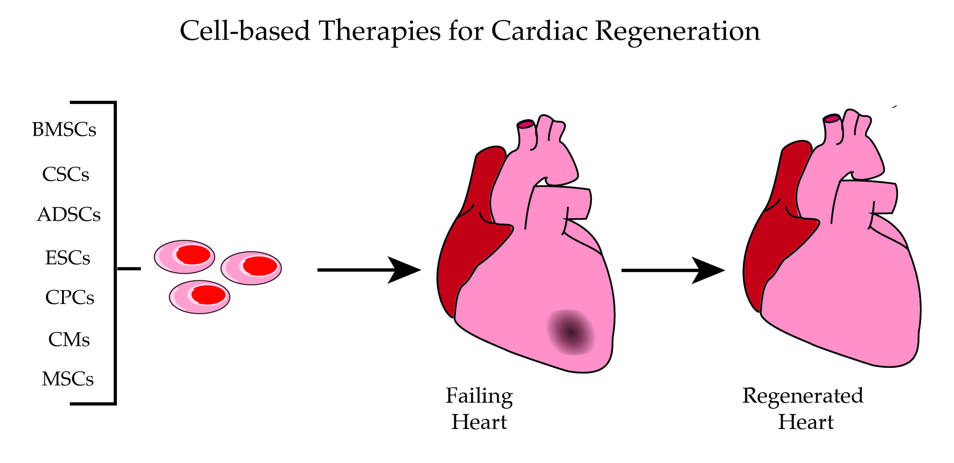
CHALLENGES
Immune Rejection: Risk of host immune system attacking transplanted cells, especially with allogeneic sources.
Cell Survival and Integration: Ensuring transplanted cells survive, integrate properly, and function long-term in the hostile ocular environment.
Delivery Method Limitations: Difficulties in safely delivering cells to precise retinal or corneal locations without causing damage.
Scar Tissue and Inflammation: Host tissue scarring and inflammation can impair cell engraftment and function.
Tumorigenicity: Risk of uncontrolled cell growth or tumor formation, especially with pluripotent stem cells.
HEART CELLS AS THERAPEUTIC AGENT
Myocardial infarction (heart attack) is a major contributor to cardiovascular diseases. During a heart attack, cardiac muscle cells (cardiomyocytes) are damaged or die due to a lack of oxygen caused by blocked blood flow.
Unlike the liver or skin, the adult human heart has very limited regenerative capacity. Once cardiomyocytes are lost, they are typically replaced by scar tissue, which cannot contract. This leads to a progressive decline in heart function, ultimately resulting in heart failure.

Slide 12
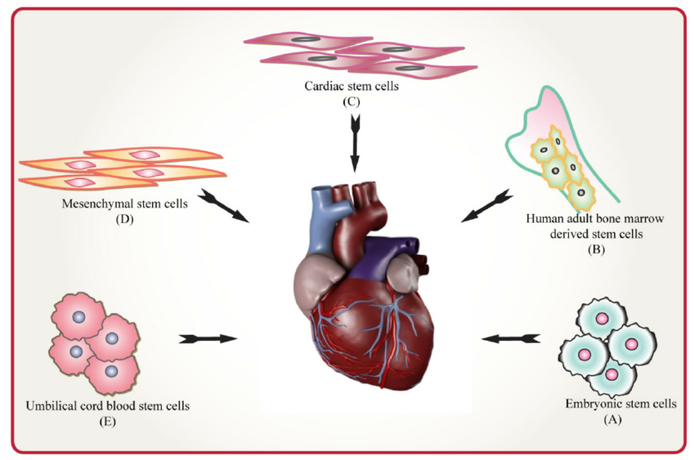
HEART CELLS AS THERAPEUTIC AGENT
Myocardial infarction (heart attack) is a major contributor to cardiovascular diseases. During a heart attack, cardiac muscle cells (cardiomyocytes) are damaged or die due to a lack of oxygen caused by blocked blood flow.
Unlike the liver or skin, the adult human heart has very limited regenerative capacity. Once cardiomyocytes are lost, they are typically replaced by scar tissue, which cannot contract. This leads to a progressive decline in heart function, ultimately resulting in heart failure.
KEY CELL TYPES USED
Cell Type | Source | Role in Therapy
Cardiomyocytes | Derived from iPSCs or ESCs | Directly replace dead or damaged heart muscle cells
Cardiac Progenitor Cells (CPCs) | Extracted from adult heart tissue | Can differentiate into cardiomyocytes, smooth muscle, or endothelial cells
Mesenchymal Stem Cells (MSCs) | Bone marrow, adipose tissue | Ind irect action via paracrine effects: anti-inflammation, angiogenesis, protection
iPSC-Derived Cardiomyocytes | Reprogrammed adult somatic cells | Autologous (patient-specific), immune-compatible, scalable source of cardiomyocytes

Slide 13
KEY CELL TYPES USED
Cell Type | Source | Role in Therapy
Cardiomyocytes | Derived from iPSCs or ESCs | Directly replace dead or damaged heart muscle cells
Cardiac Progenitor Cells (CPCs) | Extracted from adult heart tissue | Can differentiate into cardiomyocytes, smooth muscle, or endothelial cells
Mesenchymal Stem Cells (MSCs) | Bone marrow, adipose tissue | Ind irect action via paracrine effects: anti-inflammation, angiogenesis, protection
iPSC-Derived Cardiomyocytes | Reprogrammed adult somatic cells | Autologous (patient-specific), immune-compatible, scalable source of cardiomyocytes
THERAPEUTIC STRATEGIES
A. Cell Transplantation
Approach: Direct injection of cells into the myocardium or via coronary arteries.
Goal: Integrate into host tissue, improve contractility, promote healing.
Limitation: Low survival and retention of transplanted cells in the hostile post-infarct environment.
B. Tissue Engineering / Patches
Approach: Cells are seeded onto biodegradable scaffolds or biomaterials to form a cardiac patch.
Goal: Apply to infarct area to release paracrine factors and eventually integrate into tissue.
Advantage: Better cell survival, support for heart wall structure.
C. Paracrine Therapy
Approach: Use of cells (especially MSCs) to release signaling molecules without necessarily becoming heart cells.
Benefits: Reduce fibrosis (scar tissue), promote angiogenesis (new blood vessels)

Slide 14
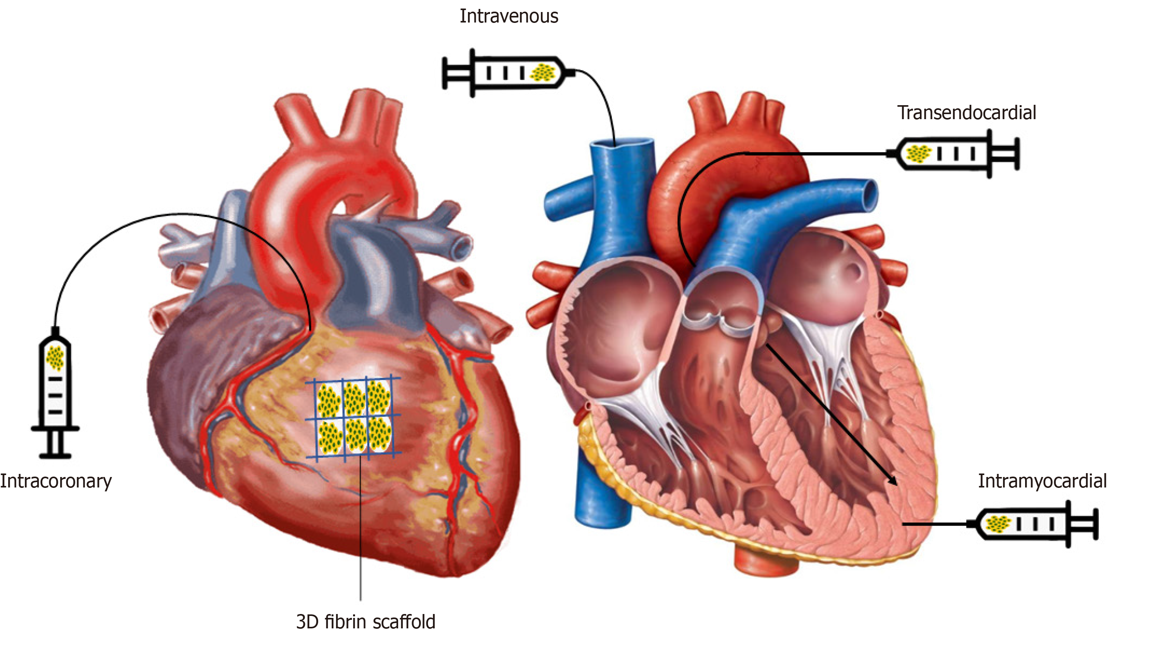
THERAPEUTIC STRATEGIES
A. Cell Transplantation
Approach: Direct injection of cells into the myocardium or via coronary arteries.
Goal: Integrate into host tissue, improve contractility, promote healing.
Limitation: Low survival and retention of transplanted cells in the hostile post-infarct environment.
B. Tissue Engineering / Patches
Approach: Cells are seeded onto biodegradable scaffolds or biomaterials to form a cardiac patch.
Goal: Apply to infarct area to release paracrine factors and eventually integrate into tissue.
Advantage: Better cell survival, support for heart wall structure.
C. Paracrine Therapy
Approach: Use of cells (especially MSCs) to release signaling molecules without necessarily becoming heart cells.
Benefits: Reduce fibrosis (scar tissue), promote angiogenesis (new blood vessels)
DELIVERY METHODS
Method | Description
Intramyocardial Injection | Direct injection into heart muscle via catheter or during surgery
Intracoronary Infusion | Delivery through coronary arteries (minimally invasive)
Epicardial Patches | Bioengineered cell-seeded patch applied to heart surface

Slide 15
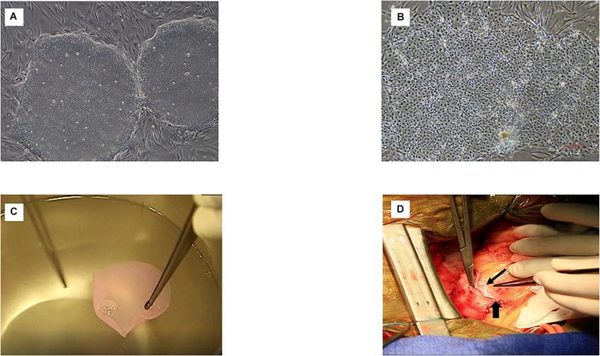
DELIVERY METHODS
Method | Description
Intramyocardial Injection | Direct injection into heart muscle via catheter or during surgery
Intracoronary Infusion | Delivery through coronary arteries (minimally invasive)
Epicardial Patches | Bioengineered cell-seeded patch applied to heart surface
CLINICAL APPLICATIONS & TRIALS
Examples:
CADUCEUS Trial: Used autologous cardiac stem cells; showed improved viable tissue but not necessarily function.
ESCORT Trial: Used embryonic stem cell-derived cardiomyocytes in a fibrin patch (France).
iPSC Trials (Japan): First-in-human implantation of iPSC-derived cardiomyocyte sheet in heart failure patients.
Reported Outcomes:
Modest improvement in ejection fraction
Reduction in scar tissue
Improved quality of life
Minimal immune complications when autologous
cells used

Slide 16
CLINICAL APPLICATIONS & TRIALS
Examples:
CADUCEUS Trial: Used autologous cardiac stem cells; showed improved viable tissue but not necessarily function.
ESCORT Trial: Used embryonic stem cell-derived cardiomyocytes in a fibrin patch (France).
iPSC Trials (Japan): First-in-human implantation of iPSC-derived cardiomyocyte sheet in heart failure patients.
Reported Outcomes:
Modest improvement in ejection fraction
Reduction in scar tissue
Improved quality of life
Minimal immune complications when autologous
cells used
CHALLENGES IN HEART CELL THERAPY
Challenge | Description
Low Cell Retention | Many cells die or wash out quickly after delivery
Arrhythmogenic Risk | Improper integration may cause irregular heart rhythms
Immune Rejection | Especially with embryonic or donor-derived cells
Manufacturing Complexities | Cost, time, and GMP (Good Manufacturing Practices) compliance needed
Integration with Host Tissue | Ensuring mechanical and electrical integration into native myocardium

Slide 17
CHALLENGES IN HEART CELL THERAPY
Challenge | Description
Low Cell Retention | Many cells die or wash out quickly after delivery
Arrhythmogenic Risk | Improper integration may cause irregular heart rhythms
Immune Rejection | Especially with embryonic or donor-derived cells
Manufacturing Complexities | Cost, time, and GMP (Good Manufacturing Practices) compliance needed
Integration with Host Tissue | Ensuring mechanical and electrical integration into native myocardium
CONCLUSION
Heart cell therapy represents a promising frontier in regenerative cardiology, with the potential to repair damaged myocardium, restore function, and improve survival. While still facing technical and clinical hurdles, ongoing research and clinical trials show encouraging progress toward practical applications.

Slide 18
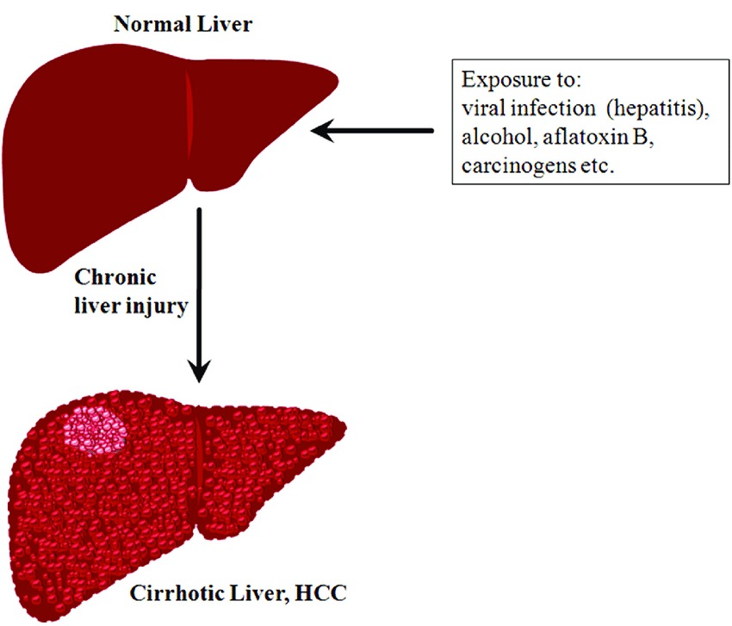
CONCLUSION
Heart cell therapy represents a promising frontier in regenerative cardiology, with the potential to repair damaged myocardium, restore function, and improve survival. While still facing technical and clinical hurdles, ongoing research and clinical trials show encouraging progress toward practical applications.
CHRONIC LIVER DISEASES
(OLT) is the only option for patients with end-stage liver disease.
LTE aims to regenerate functional liver tissues using hepatic cells (3D) biomaterial scaffolds to facilitate cell growth and function.

Slide 19
CHRONIC LIVER DISEASES
Chronic liver disease is progressive detorigation of liver function leading to fibrosis and cirrohsis.
(OLT) is the only option for patients with end-stage liver disease.
LTE aims to regenerate functional liver tissues using hepatic cells (3D) biomaterial scaffolds to facilitate cell growth and function.
MECHANISM
Cells:
Hepatocytes are liver parenchyma cells and endothelial cells resident of macrophage.
Interaction between hepatocytes and surrounding cells along with microenvirnment is neccessary for maintenance and proper function.
Scaffolds:
Cells embedded with artificial scaffolds having capacity to generate replicate and generate new ECM.
Biocamptability of scaffolds permit concurrent generation of new tissue along with matrix degradation.

Slide 20
MECHANISM
Cells:
Hepatocytes are liver parenchyma cells and endothelial cells resident of macrophage.
Interaction between hepatocytes and surrounding cells along with microenvirnment is neccessary for maintenance and proper function.
Scaffolds:
Cells embedded with artificial scaffolds having capacity to generate replicate and generate new ECM.
Biocamptability of scaffolds permit concurrent generation of new tissue along with matrix degradation.
Engineered Tissue:
3D culturing system contains ECM proteins which is made of hydrogels such as collagen
3D bioprinting aims to fabricate self assembled construction of cells using micro tissue as building blocks
Cells are suspended in hydrogels known as bio-inks which can be either natural like collagen and gelatin or synthetic such as polyvinylpyrrolidone(PVP) or polyethelyn gycol(PVP).
Decellularized is suitable for scaffold with proper and specific microstructure for implantation fo cells.

Slide 21
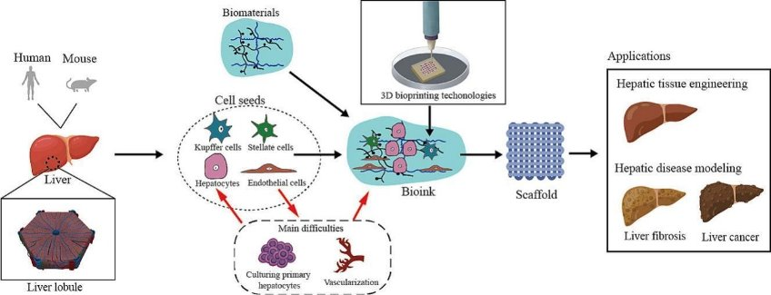
MECHANISM
Engineered Tissue:
3D culturing system contains ECM proteins which is made of hydrogels such as collagen
3D bioprinting aims to fabricate self assembled construction of cells using micro tissue as building blocks
Cells are suspended in hydrogels known as bio-inks which can be either natural like collagen and gelatin or synthetic such as polyvinylpyrrolidone(PVP) or polyethelyn gycol(PVP).
Decellularized is suitable for scaffold with proper and specific microstructure for implantation fo cells.
Implantation:
The enginerred liver is surgically implanted inside the patient.
Liver-on-a-chip or micro-platform-based bioreactor could provide a patient specific environment.

Slide 22
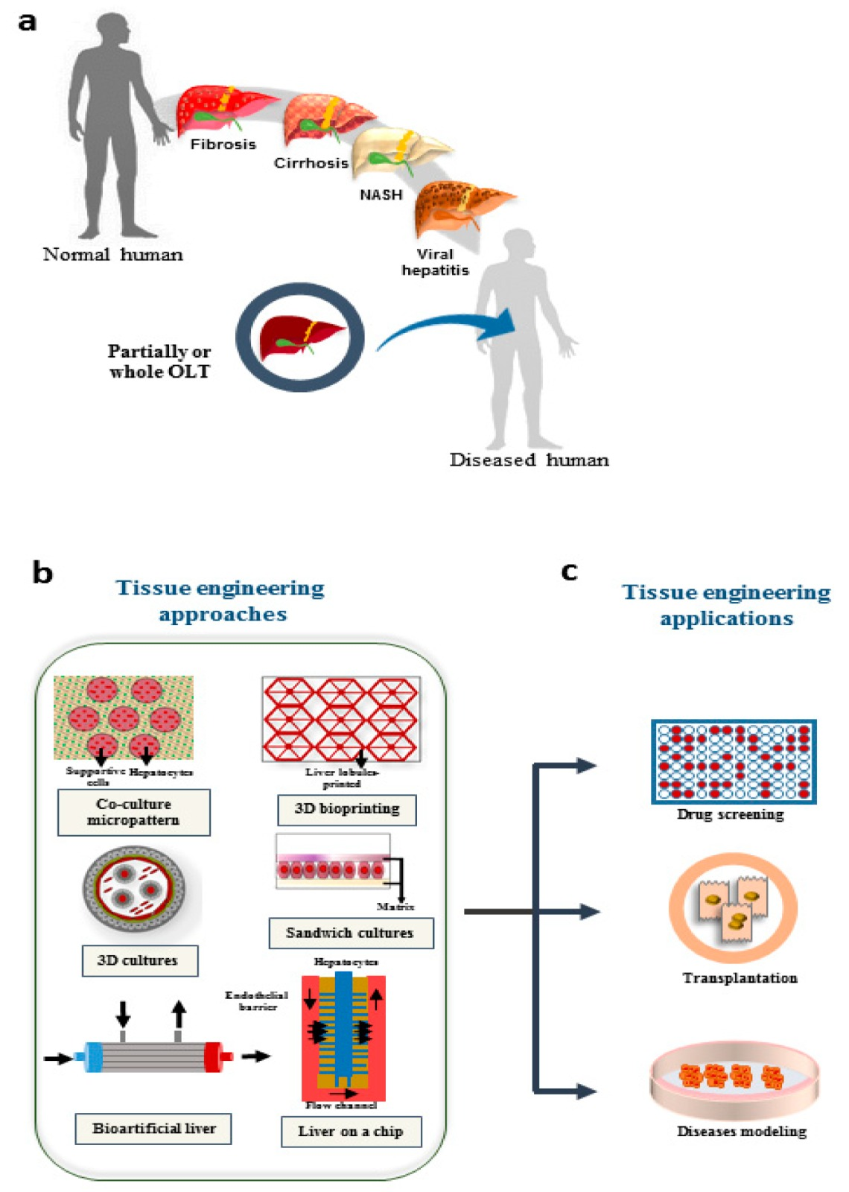
MECHANISM
Implantation:
The enginerred liver is surgically implanted inside the patient.
Liver-on-a-chip or micro-platform-based bioreactor could provide a patient specific environment.
ADVANTAGES
Restoring function
Disease models
Testing therapies
Reducing the need for organ transplants and animal testing.
Drug development
Personalized medicine

Slide 23
ADVANTAGES
Restoring function
Disease models
Testing therapies
Reducing the need for organ transplants and animal testing.
Drug development
Personalized medicine
KNEE CELL THERAPY
Often referred to as regenerative cell therapy or stem cell therapy.
A treatment approach used to address various knee problems, such as joint pain, cartilage damage, and osteoarthritis.
The cells used are :
Stem Cells
Platelet-rich plasma (PRP) cells
Mesenchymal Stem Cells

Slide 24
KNEE CELL THERAPY
Often referred to as regenerative cell therapy or stem cell therapy.
A treatment approach used to address various knee problems, such as joint pain, cartilage damage, and osteoarthritis.
The cells used are :
Stem Cells
Platelet-rich plasma (PRP) cells
Mesenchymal Stem Cells
STEP BY STEP PROCEDURE
Anesthesia is given to keep the patient comfortable.
The surgeon removes damaged bone and cartilage.
An artificial joint is placed and secured in position.
The incision is closed and the knee is bandaged.

Slide 25
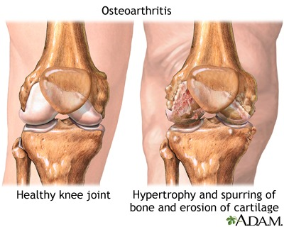
STEP BY STEP PROCEDURE
Anesthesia is given to keep the patient comfortable.
The surgeon removes damaged bone and cartilage.
An artificial joint is placed and secured in position.
The incision is closed and the knee is bandaged.
CONDITIONS TREATED BY KNEE CELL THERAPY
Osteoarthritis
Meniscal Tears
Ligament Injuries
Knee cartilage damage

Slide 26

CONDITIONS TREATED BY KNEE CELL THERAPY
Osteoarthritis
Meniscal Tears
Ligament Injuries
Knee cartilage damage
STEM CELL THERAPY FOR PROFESSIONAL ATHLETES
A soccer player chose stem cell therapy over ACL surgery.
Stem cells were used to heal and reduce inflammation.
Recovery was faster with improved knee stability.
The case supports stem cell use for ACL injuries.

Slide 27
STEM CELL THERAPY FOR PROFESSIONAL ATHLETES
A soccer player chose stem cell therapy over ACL surgery.
Stem cells were used to heal and reduce inflammation.
Recovery was faster with improved knee stability.
The case supports stem cell use for ACL injuries.
BENEFITS OF KNEE CELL THERAPY
Promotes natural healing and tissue regeneration.
Reduces pain and inflammation without major surgery.
Speeds up recovery and return to activity.
May improve joint function and long-term stability.

Slide 28
BENEFITS OF KNEE CELL THERAPY
Promotes natural healing and tissue regeneration.
Reduces pain and inflammation without major surgery.
Speeds up recovery and return to activity.
May improve joint function and long-term stability.
THANK YOU

Slide 29

THANK YOU

